Slide 1
Web developer-roadmap
2018
https://github.com/kamranahmedse/developer-roadmap

Slide 2
Disclaimer
The purpose of this roadmap is to give you an idea about the landscape and to guide you if you are confused about what to learn next and not to encourage you to pick what is hip and trendy. You should grow some understanding of why one tool would better suited for some cases than the other and remember hip and trendy never means best suited for the job

Slide 3
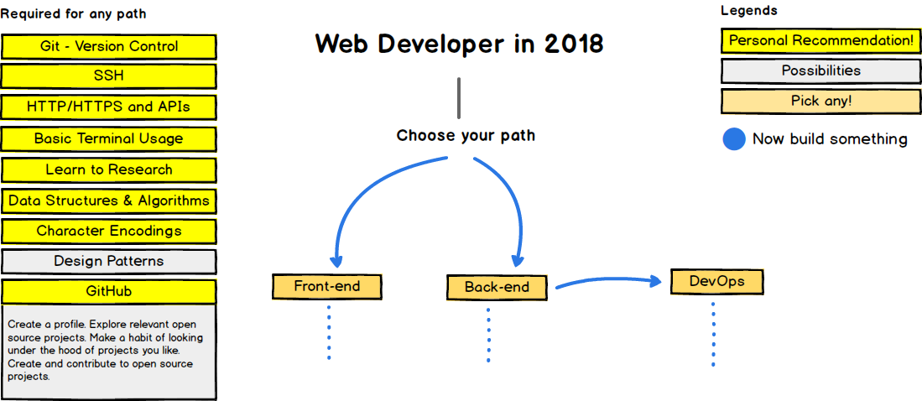
Introduction

Slide 4
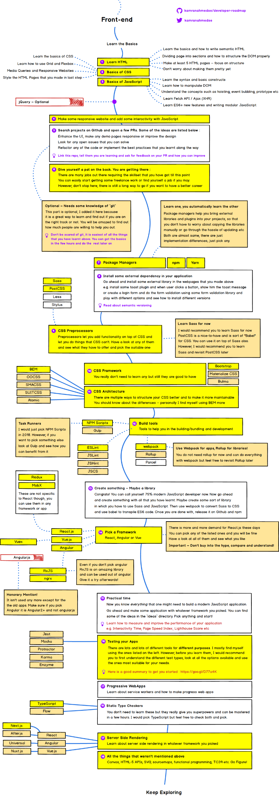
Frontend Dev

Slide 5
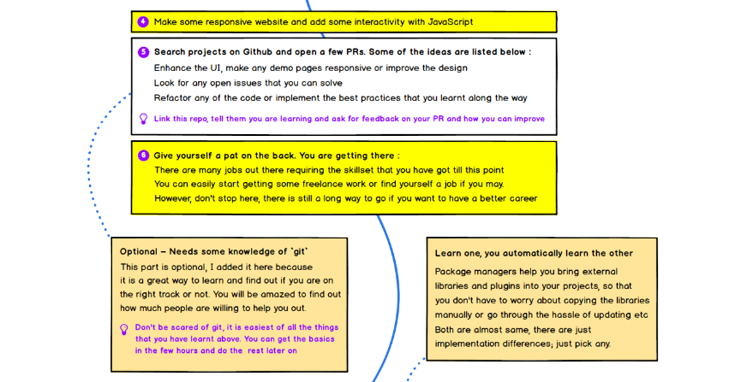
Frontend Dev

Slide 6
Frontend Dev

Slide 7

Frontend Dev

Slide 8
Frontend Dev

Slide 9
Backend

Slide 10
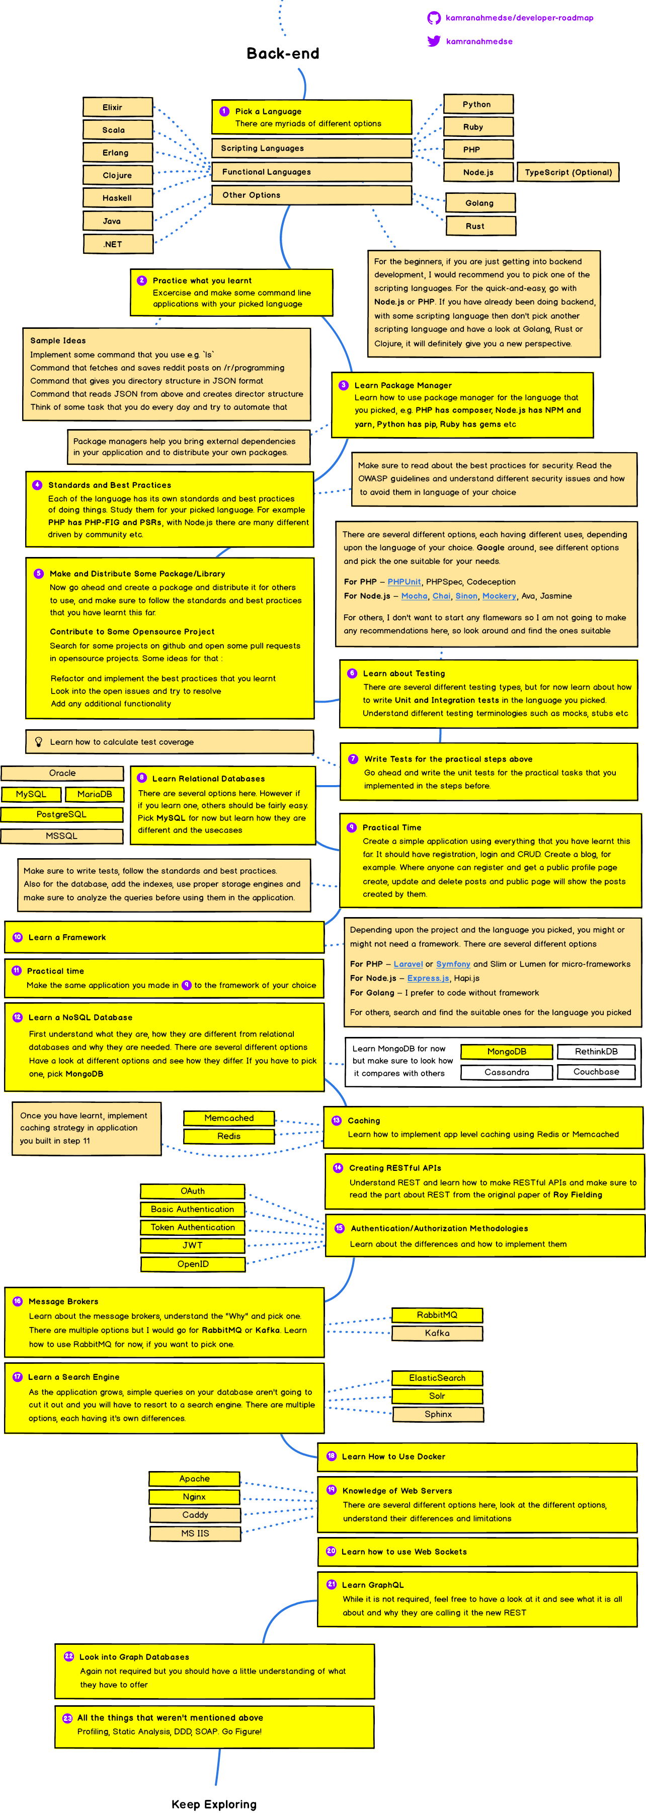

Slide 14
DevOps

Slide 15
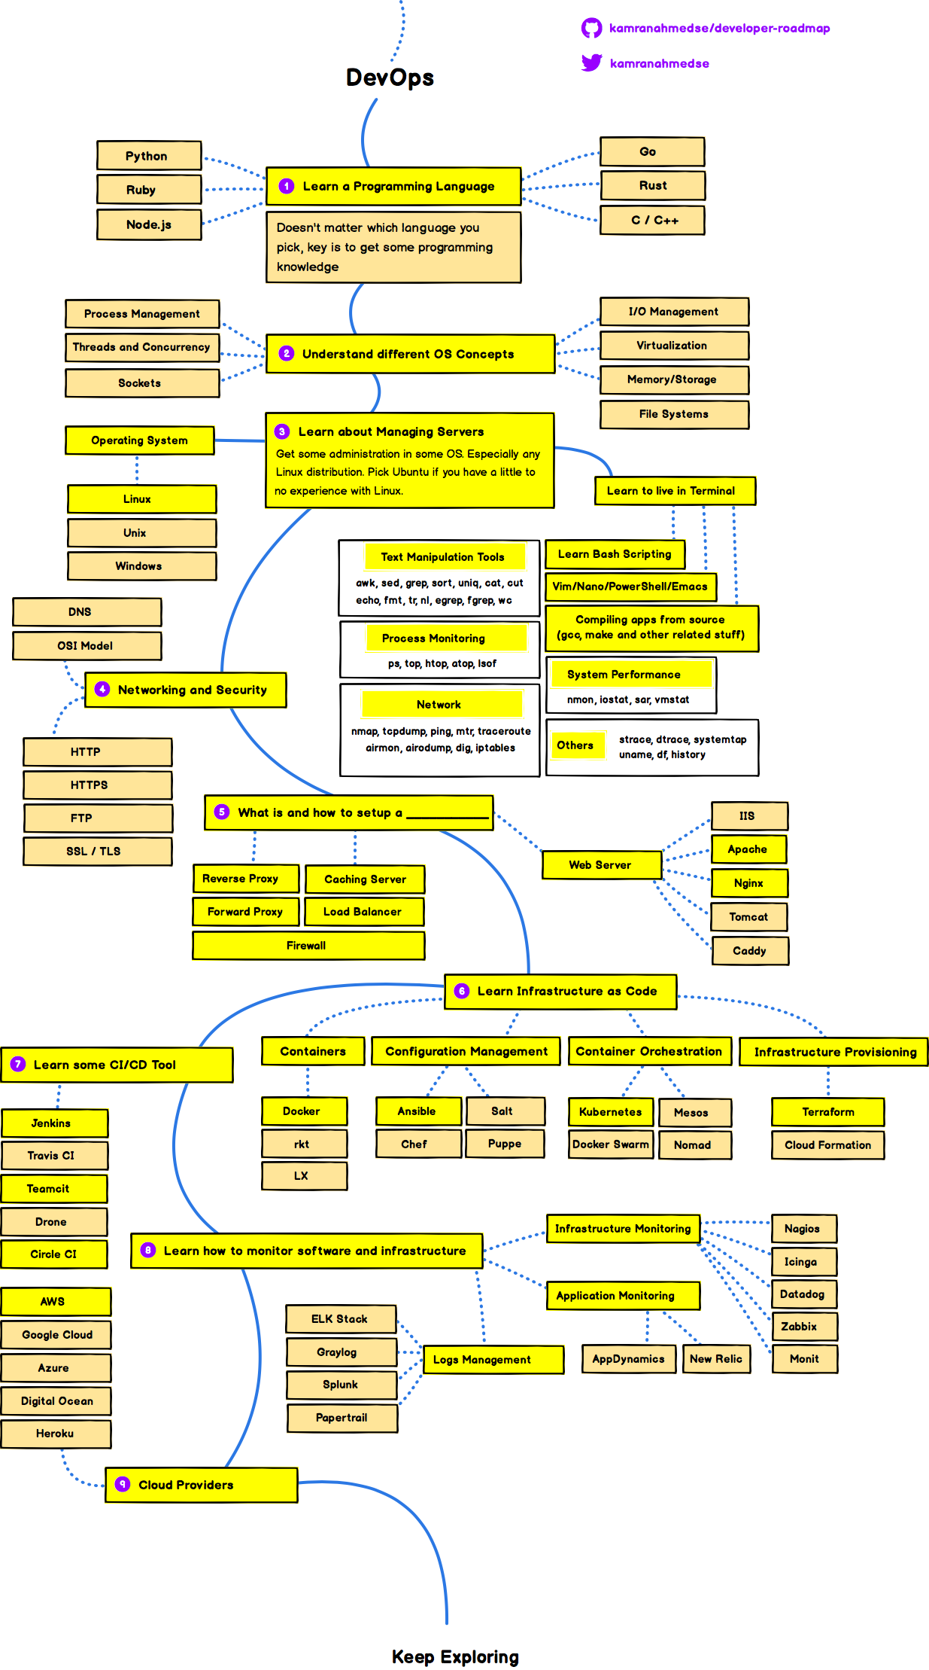

Slide 19
Keep Exploring…

